Slide 1
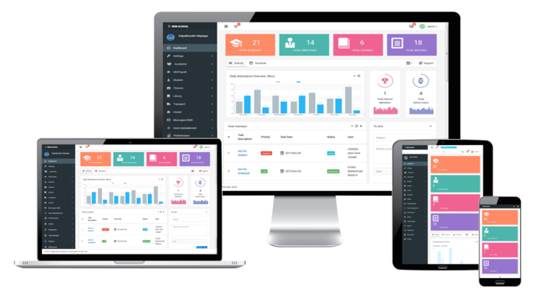
Student Results Management System User Guide
Group 16 - Team members:
Dharmarathna N.S. E/18/077 Mihiranga G.D.R. E/18/224 Mudalige D.H. E/18/227

Slide 2
Content:
Installation steps
2) Instructions for Admin
How to register to the application
How to register courses
3) Instructions for Student
How to register to the application
How to calculate current GPA
How to access other main features

Slide 3

Introduction
The aim of this project is to build a mobile application to manage and analyze undergraduate students’ marks.

Slide 4
Installation Steps:
Download the APK file to the phone
Give necessary permissions and install the application

Slide 5
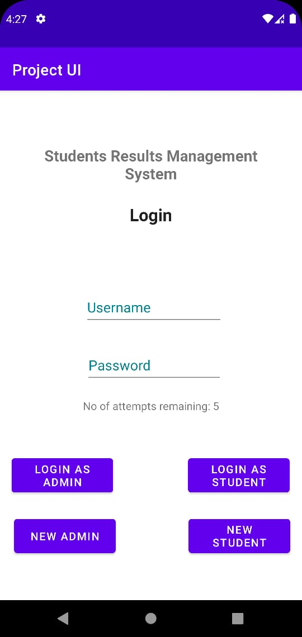
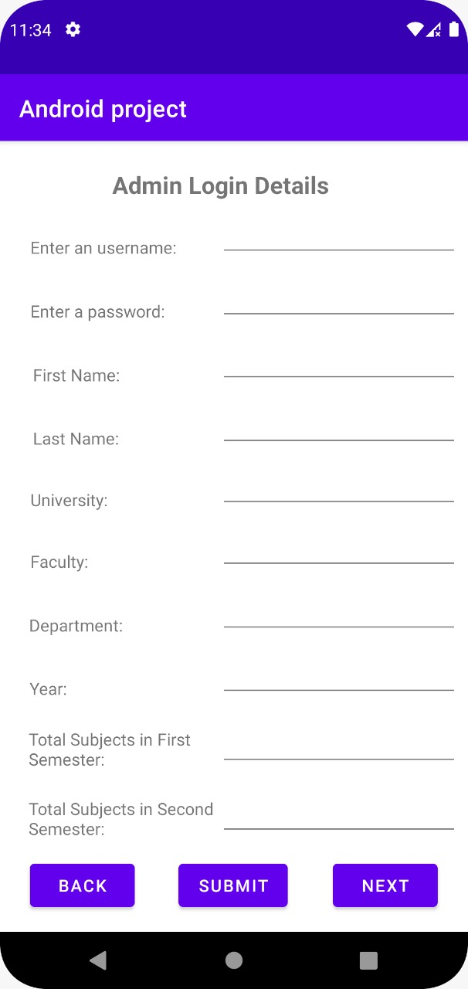
Instructions for Admin:
1) How to register to the application
Click NEW ADMIN button
Enter required details and submit

Slide 6
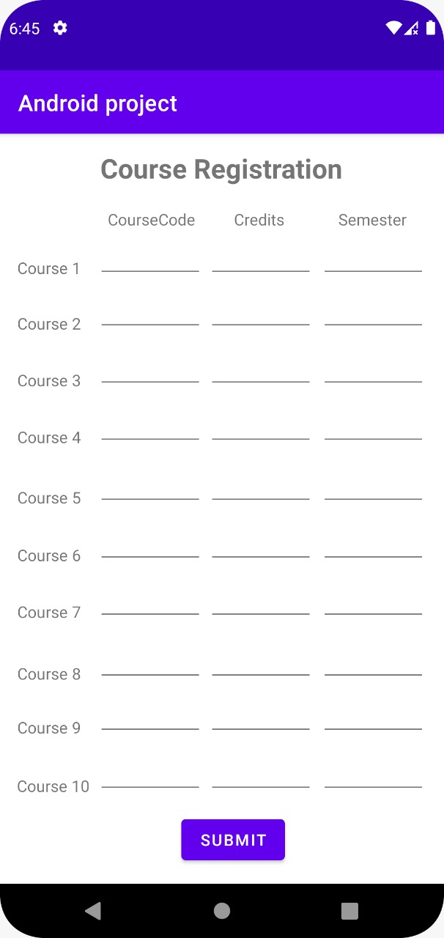
Instructions for Admin:
2) How to register courses
Login to application by giving username and password
Enter the course code, credits and semester of the courses which should be registered

Slide 7
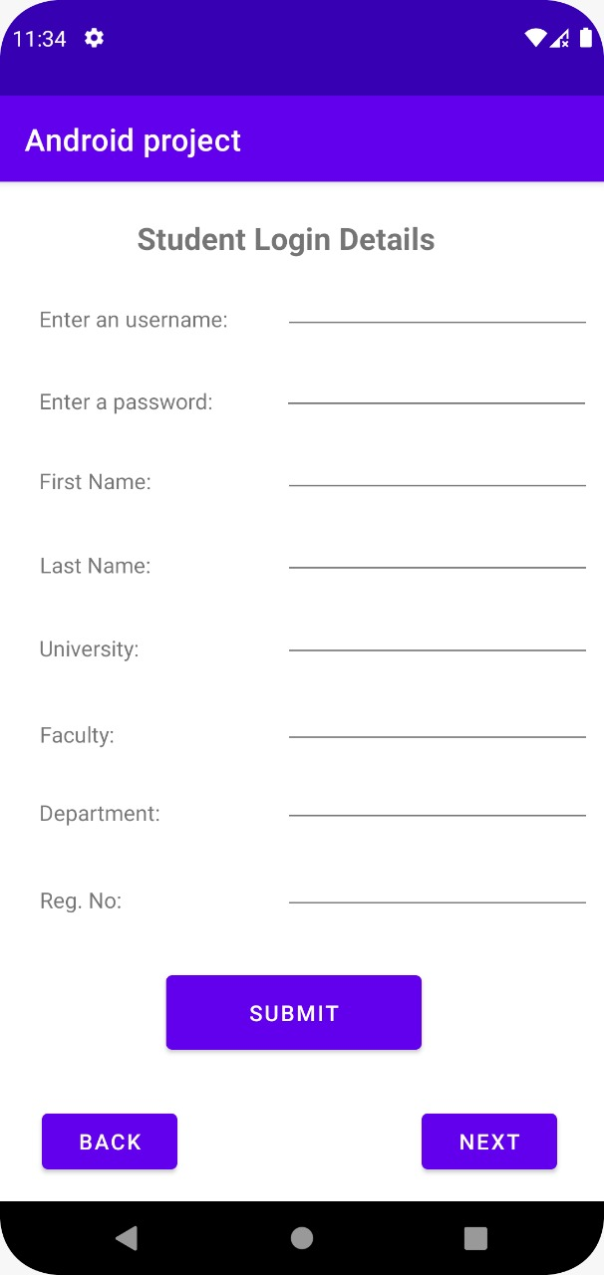
Instructions for Student:
1) How to register to the application
Click NEW STUDENT button
Enter required details and submit

Slide 8
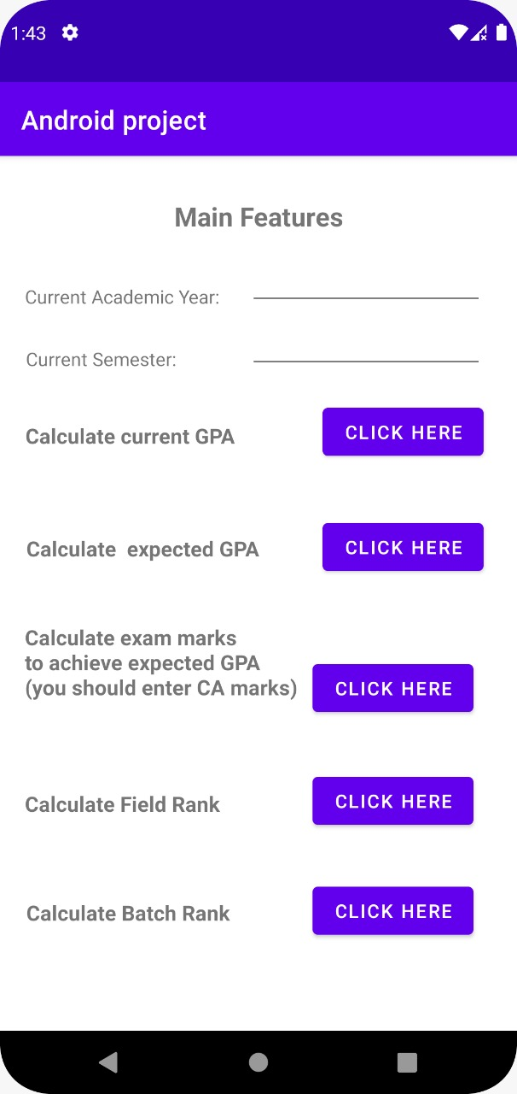
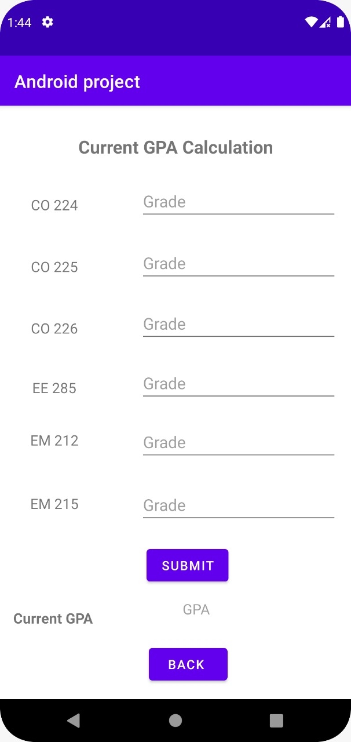
Instructions for Student:
2) How to calculate current GPA
Login to application by giving username and password
Enter the data in the
Main feature page. Click
the button relevant to
calculate current GPA
Enter the grades of the courses and submit

Slide 9
Instructions for Student:
3) How to access other main features
Login to application by giving username and password
Enter the data in the main feature page. Click the button relevant to the necessary feature

